Slide 1
HTTP5126 Database final: Animal Sanctuary Donors and Donations
Deryn Boscariol

Slide 2
Issues
Donations to specific animals: Donors to the animal sanctuary can direct their donations to a specific animal. I am solving how an employee of the sanctuary can see the total donated funds for each animal and have the column automatically update when a new donation is made.
VIP donors: The animal sanctuary wants to start a VIP program for its top donors. Donors who have donated at least $200 will receive a discount on tickets and a stuffed animal based on the animal they have donated most to. I am solving how an employee could find out which donors are in the VIP program and what their most donated to animal is.

Slide 3
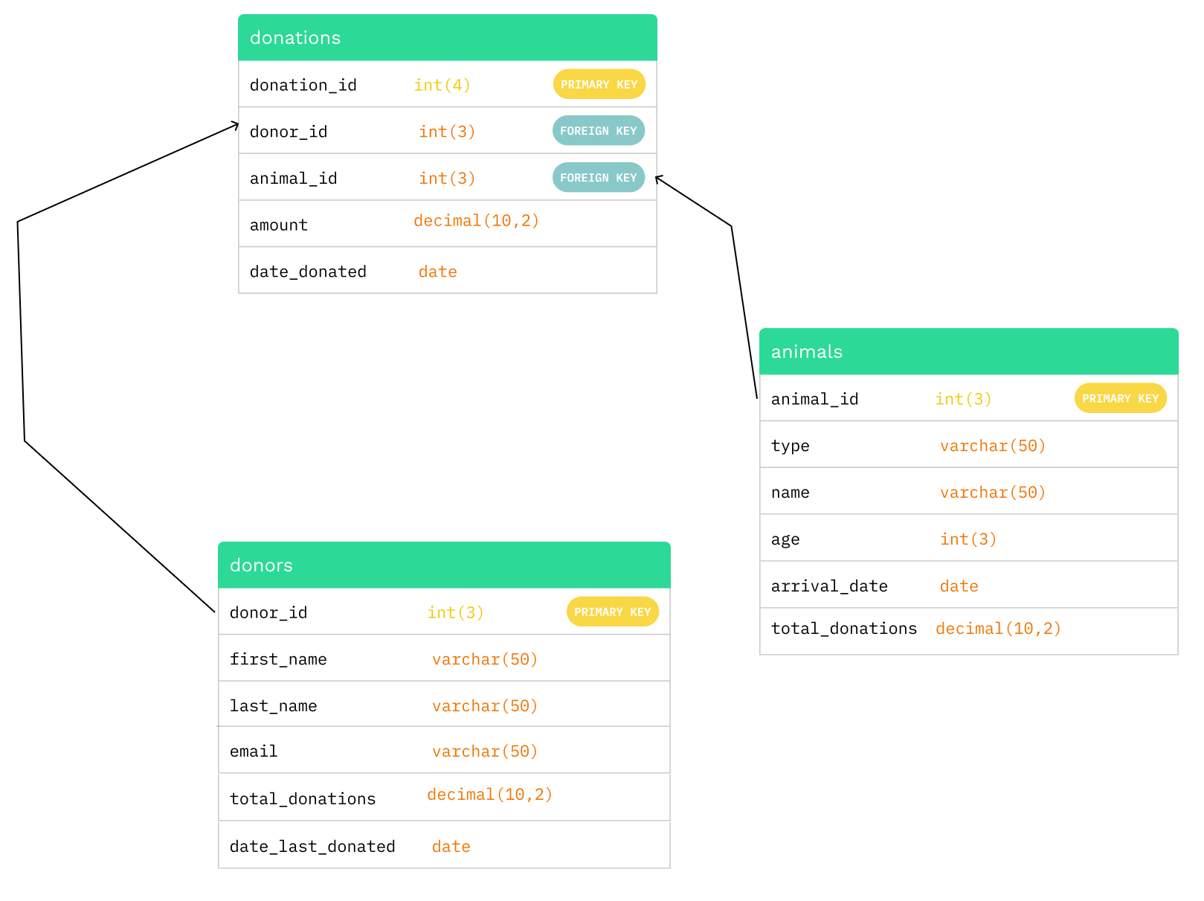
Structure
One to Many Relationship
Each donation can have only one donor and be sent to one animal
However, one donor can make multiple donations and one animal can receive multiple donations

Slide 4
Solutions
Define VIP program: VIEW
CREATE VIEW vip_program
AS SELECT donor_id, first_name, last_name, total_donations, date_last_donated
FROM donors
WHERE total_donations >= 200;
Find favourite animal: FUNCTION
CREATE FUNCTION FindFavAnimal(p_donor_id INT) RETURNS INT
RETURN ( SELECT animal_id
FROM donations
WHERE donor_id = p_donor_id
GROUP BY animal_id
ORDER BY SUM(amount) DESC LIMIT 1);
Update donation total per animal: TRIGGER
CREATE TRIGGER update_animalDonation_new
AFTER INSERT
ON donations
FOR EACH ROW
UPDATE animals
SET total_donations = total_donations + NEW.amount
WHERE animals.animal_id = NEW.animal_id
Notes:
To solve my first issue I created a trigger that updates the total_donations column on the animals table after there is a new donation inserted on the donations table
For my second issue I first created a view to define which donors donated 200 or more dollars and therefore are a part of the vip program
Then to find the type of stuffed animal a selected vip donor will receive I created the findFavAnimal function which receives a donor id and returns the id of the animal that they have donated to the most

Slide 5
Code demo
Notes:
(display trigger) Add a new donation
INSERT INTO `donations` (`donation_id`, `donor_id`, `animal_id`, `amount`, `date_donated`)
VALUES (NULL, '22', '5', '100', '2024-04-10’);
Display vip view
SELECT * FROM vip_program;
Call function to find fav animal
SELECT *
FROM
animals
WHERE animal_id = FindFavAnimal(18);

